Slide 1

Lecture 17: Review Peer Comments on Your Prototype
Dr. Tsung-Wei Huang
Department of Electrical and Computer Engineering
University of Utah, Salt Lake City, UT
Notes:
Hello everyone, today we are going to review on other people’s comments on your prototype. Remember last week we ask each group to include a prototype section in your project website. That section is what you will present in the end of the semester. Also, we ask each group to review other groups’ prototype and give his or her feedback on the github. So, today we are going to review those comments.

Slide 2

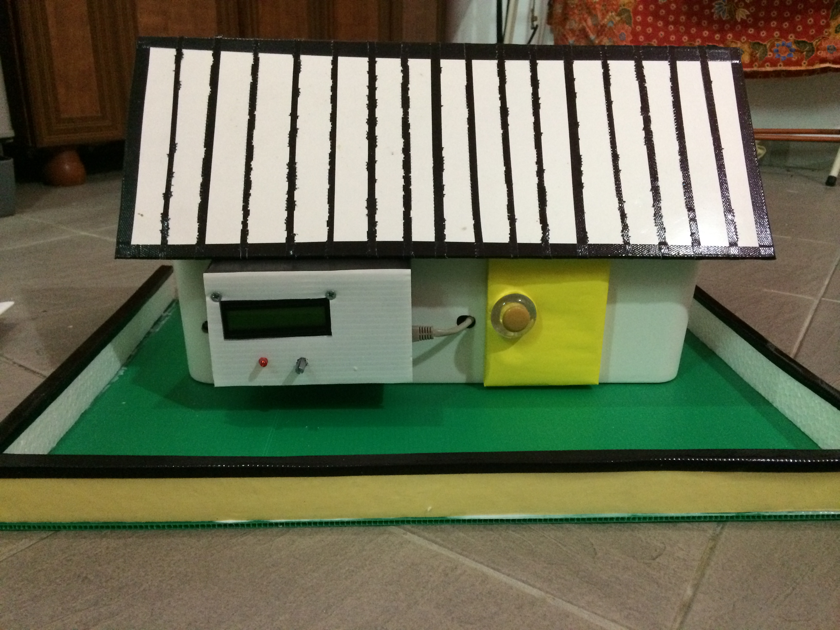
Prototype Recap
What is a prototype?
Final Goal: A house
Prototype: a small type of work to demonstrate the feasibility of your proposed approach to the final goal.
Key question: why should I believe in your proposed technical work?
Notes:
We have talked about what a prototype is multiple times. There are no universal rules that tell you what you need to do with your prototype. It is project-dependent. Different projects have different prototypes. A Prototype is a small type of work to demonstrate the feasibility of your proposed approach to the final goal. Put it another way, it is something you demonstrate to other people such that when they see your prototype, they believe in your proposal, and proposed technical work.
This is like you propose to build house, then in the final presentation you need to demonstrate you are able to build a house. You may come up with a small structure of the house even though it is still far from the final product, but at least you show me you know what the structure of a house is. It has window, it has roof, it has doors, and so on.
By looking at this picture, you can immediately get the sense about what a prototype is.

Slide 3
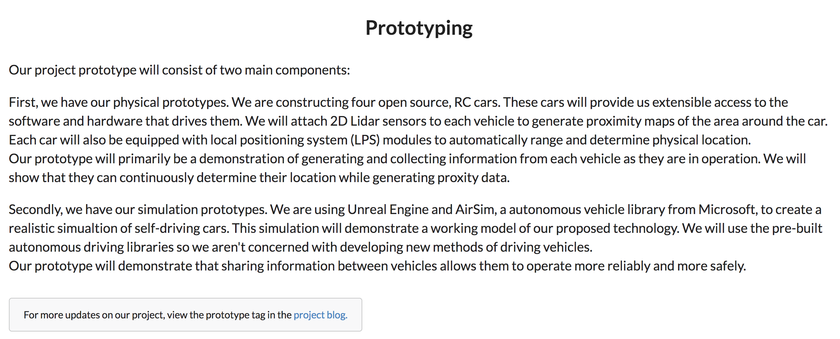
Example 1: MercuryMesh
https://mercurymesh.dev/
Notes:
Let’s take a look at some examples from you. MeucuryMesh is one project that tries to enable autonomous vehicles to communicate with each other in real-time; Wow, like tesla. Imagine you are investors, if someone propose to you he or she wants to build autonomous vehicles, what do you expect the team to come up in terms of prototype.
Let’s take a look at this prototype. (…)
What do you think? For me, this is a very good paragraph that explains the prototype. It is very specific. After reading this I immediately know what this team is going to demonstrate in the prototype. First, they want to demonstrate they are able to collect information from driving cars, which is an essential component for autonomous driving system. Of course this is very critical for autonomous driving system, if you are not able to collect information from driving cars, how do you make it autonomously drive.
Now, the second item in the prototype is a simulation tool, which totally makes sense. Once you have data collected from driving cars, the next step is to simulate different kinds of situations based on data. For example, you want to make sure you don’t follow too close to the other cars, or you want to find out when to stop on red or when to move on green.
Overall, this is a very specific prototype plan for autonomous driving cars.

Slide 4
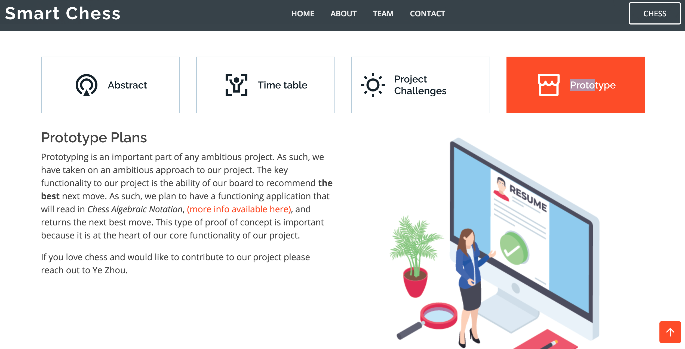
Example 2: Smart Chess
https://jason-zavala.github.io/smartchess/
Notes:
Let’s look at the second project example. SmartChess, is a project to create a smart chess board that enables users to learn to play chess and play against an AI.
This is their prototype plans. (…)
Again, this prototype plan is very specific, right? IT is very related to the final goal of the project. Essentially, they want to have a software applications that will read in the chess format, you know, like the chess note, situations of the current playing, to a software program that can generate the next move.
This plan also sounds very realistic because I am sure there are plenty software packages that can help you out with this. Several years ago we have this google Alpha Go that defeat the best human player. I am sure this prototype is doable, considering the plenty resources in AI-based gaming.

Slide 5
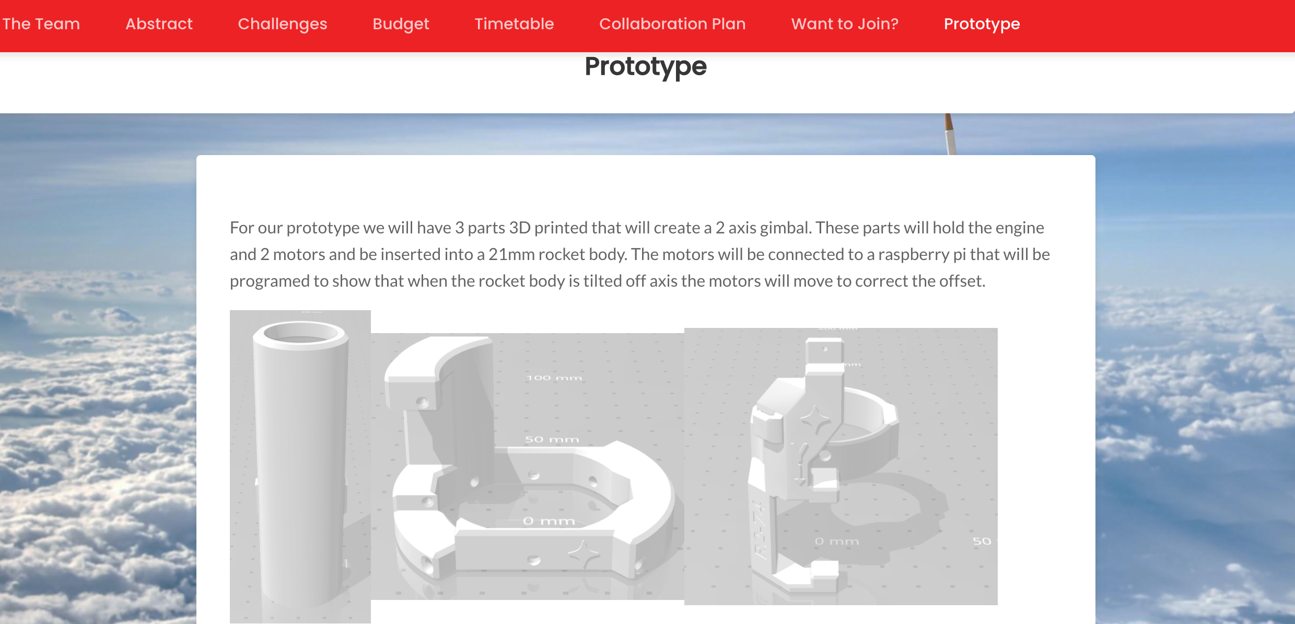
Example 3: VectorU
https://vectoru.space/prototype/
Notes:
Another example is VectorU, that tries to bring the technology of thrust vectoring to model rockets for education and entertainment.
Let’s look at his prototype.
Somehow I found the grammar is not that smooth. But it is still very specific. The prototype wants to demonstrate several parts using 3D printers to create gimbals. The connection to the motor will be based on raspberry pi.
Overall this is good, but there is a catch. The project goal metions education and entertainment, but I didn’t see how the prototypes are linked to the two goals. Some of you also gave the similar comment.

Slide 6
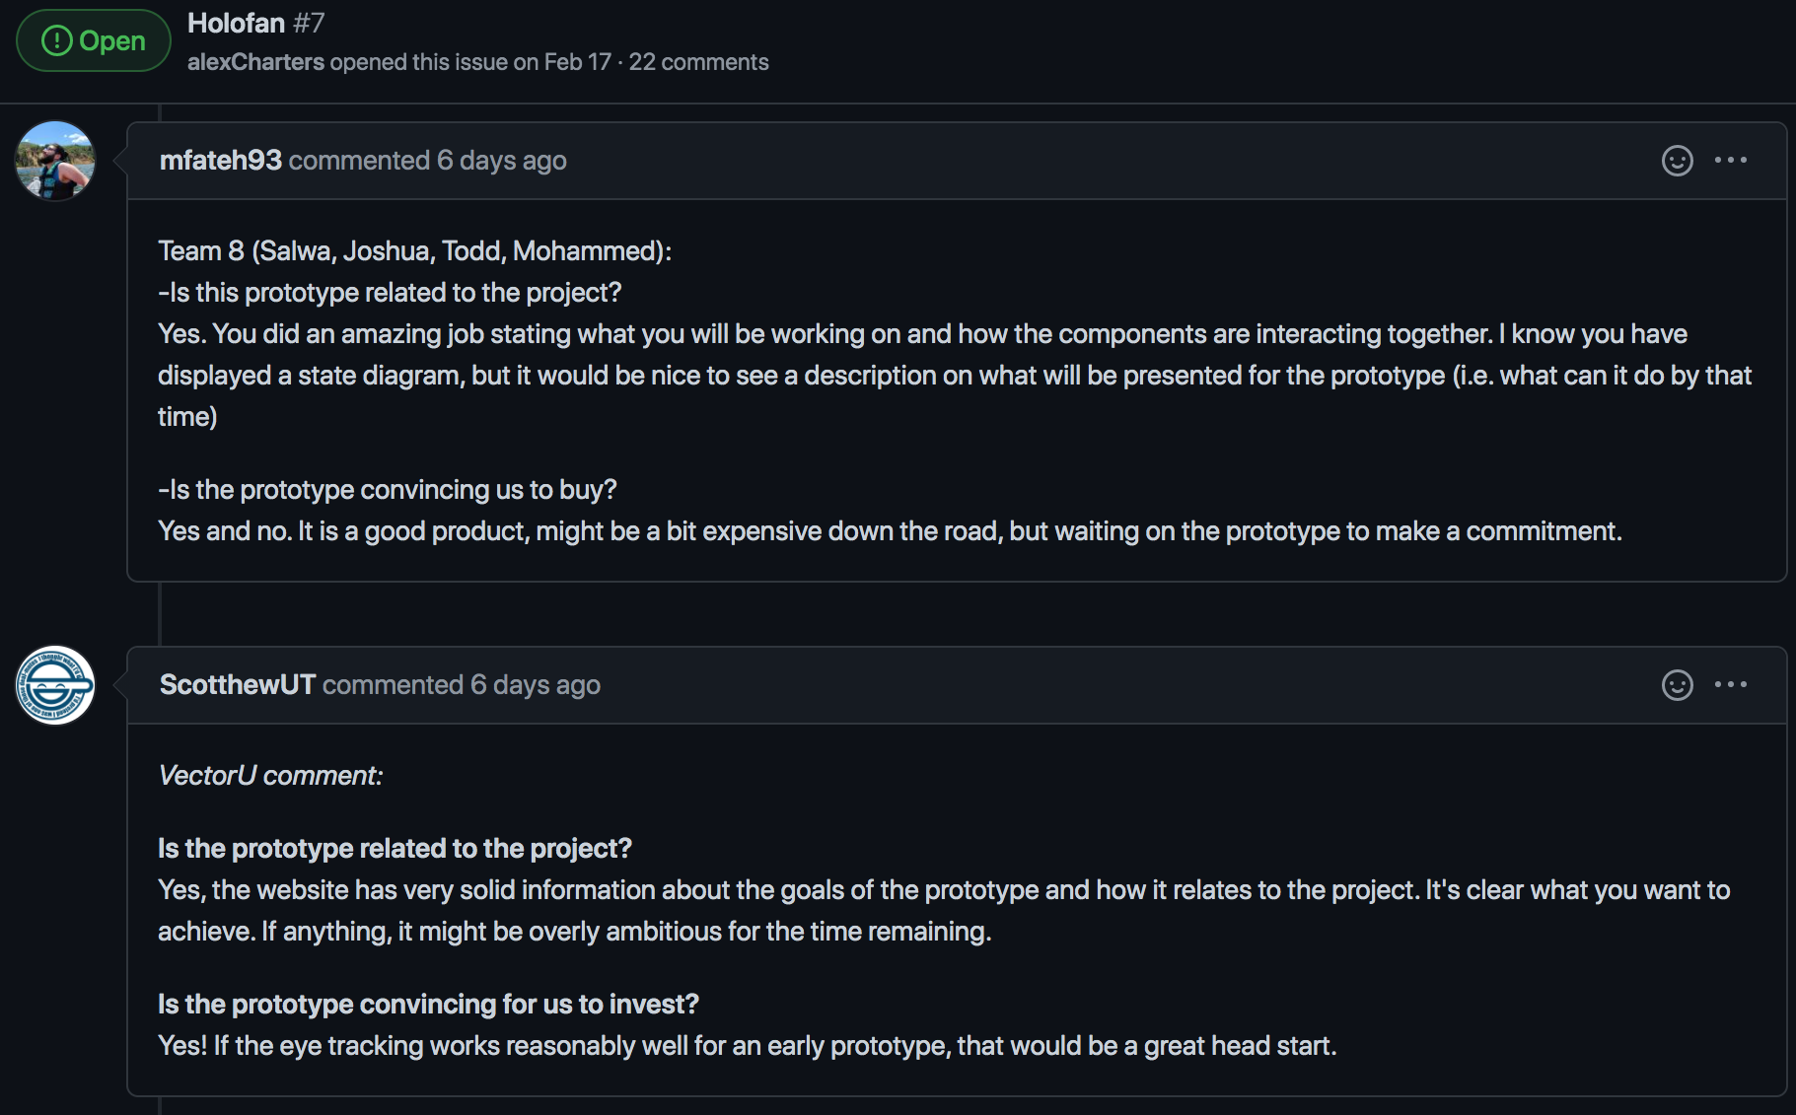
Peer Evaluation for Prototype
Each team should receive other’s comment
https://github.com/tsung-wei-huang/cs3992/issues
Notes:
Like I said, prototype is something you want to demonstrate to other people to show you are capable of doing this: you should approve the contract!
So, last two lectures, we ask each team to review other teams’ prototypes listed in their websites and provide constructive criticism on two questions. # is the prototype related to the project? Is the project convincing for you to invest?
Many of you gave good comments, some are harsh which is good for other teams to reflect on themselves to improve the prototype.

Slide 7
Why Peer Evaluation is Important?
Prototype is built to demonstrate to others
You need to demonstrate a prototype when you
Launch a new project in a company
Launch a start-up
Launch a research project
…
You need to let others know you can do it
OK, now I trust your technical capability
OK, now I know your idea is realistic
Notes:
I cannot emphasize more on the importance of peer evaluation. Prototype is built to demonstrate to others, and you need to demonstrate a prototype in a lot of situations in your future career, for example, when you want to launch a new project in a company and lead the effort of the project execution, you need to convince your manager that your idea is going to work. Then, you need to show your manager a prototype of your idea.
Same for launching a start-up if you have a great idea. You need to demonstrate to your potential investors about your idea and the best way to gain their trust is to have a workable prototype.
Or, like me, as a university faculty, I need to do a lot of new research projects and I need to get funding from different agencies to support my proposed research projects. Then I need to show them some preliminary results or prototypes such that they will believe in my proposal and give me research grant.
You need to let others know you can do it. By reading your proposal and prototype, I trust your technical capability and I know your proposed ideas are realistic.

Slide 8
Project Prototype Discussion
We have opened 10 breakout rooms
Zoom: https://utah.zoom.us/j/2468214418
1-9 are assigned for each team
Thesis track students are in room 10
Each group works together to do the following:
Review others’ comments on your prototype at your project issue post: https://github.com/tsung-wei-huang/cs3992/issues
Discuss two items:
Do people correctly understand what you plan to do?
What do you plan to improve based on these comments?
We will come back to have each team to speak
Notes:
So, today, we are going to do again the group discussion. We will open 10 breakout rooms, room #1 to #9 are assigned for each team, and thesis track students will stay in room 10. Each group works together to do the following …

Slide 9
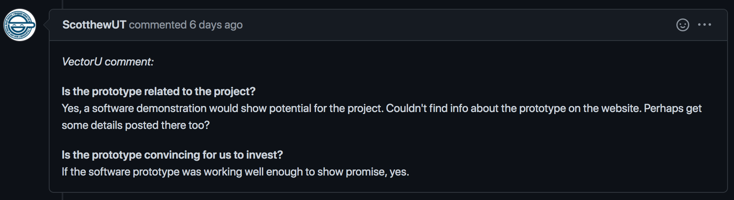
To Get You Off the Ground
Step #1: Visit the your project post
https://github.com/tsung-wei-huang/cs3992/issues
Step #2: Review comments on your prototype
Step #3: Discuss the two items in the worksheet
https://docs.google.com/spreadsheets/d/1JfWZkEyoXdVLtHkiwOqk24G7WVhLWMCP113cSe9fgsQ/edit#gid=771236172
Check in your attendance by marking your name in bold
Step #4: Select one person to present
Notes:
To get you off the ground quickly, when you join your break room, visit your project announcement at the Github issue page to carefully review other students’ comments on your project prototype. Then, discuss the two items in the worksheet, “do people correctly understand what my prototype is?” and “what can we improve based on the comments?”
During the discussion, please check in your attendance by marking your name in bold.
Finally, select one person to present the two items when we come back to the main room at around 12:50.
I will post the links on the chat box.

